Slide 1

Bin & Charlotte

Slide 2
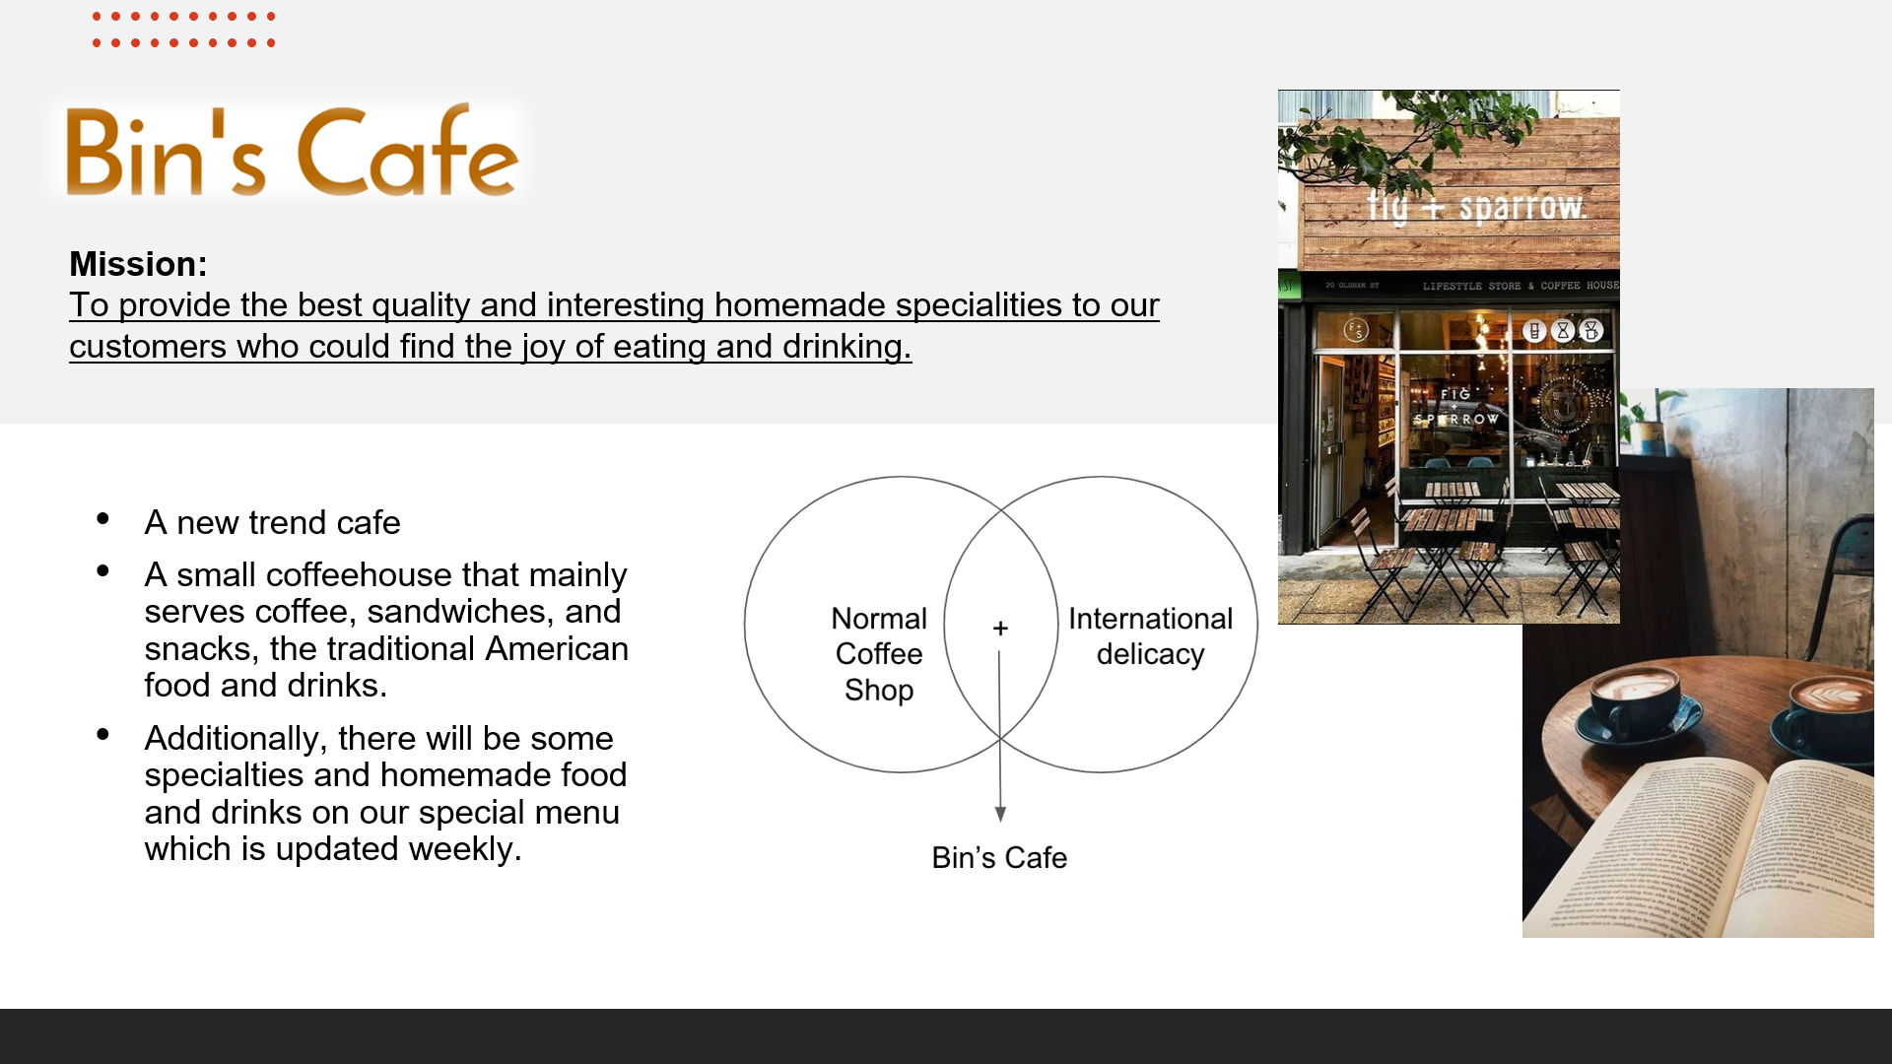

Slide 3
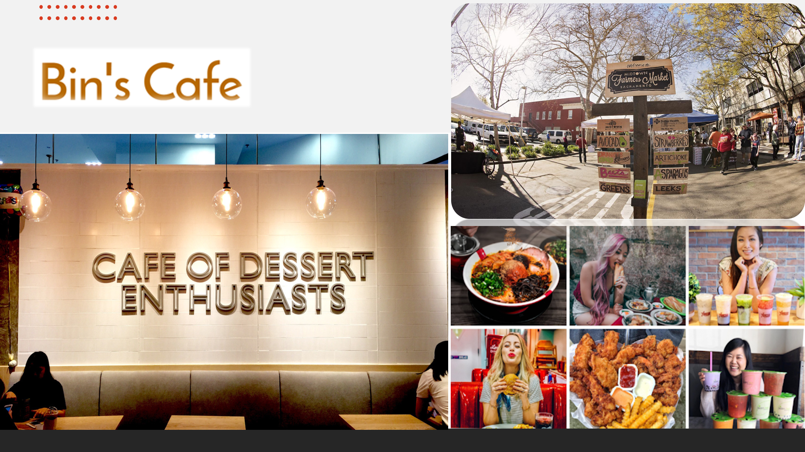

Slide 4
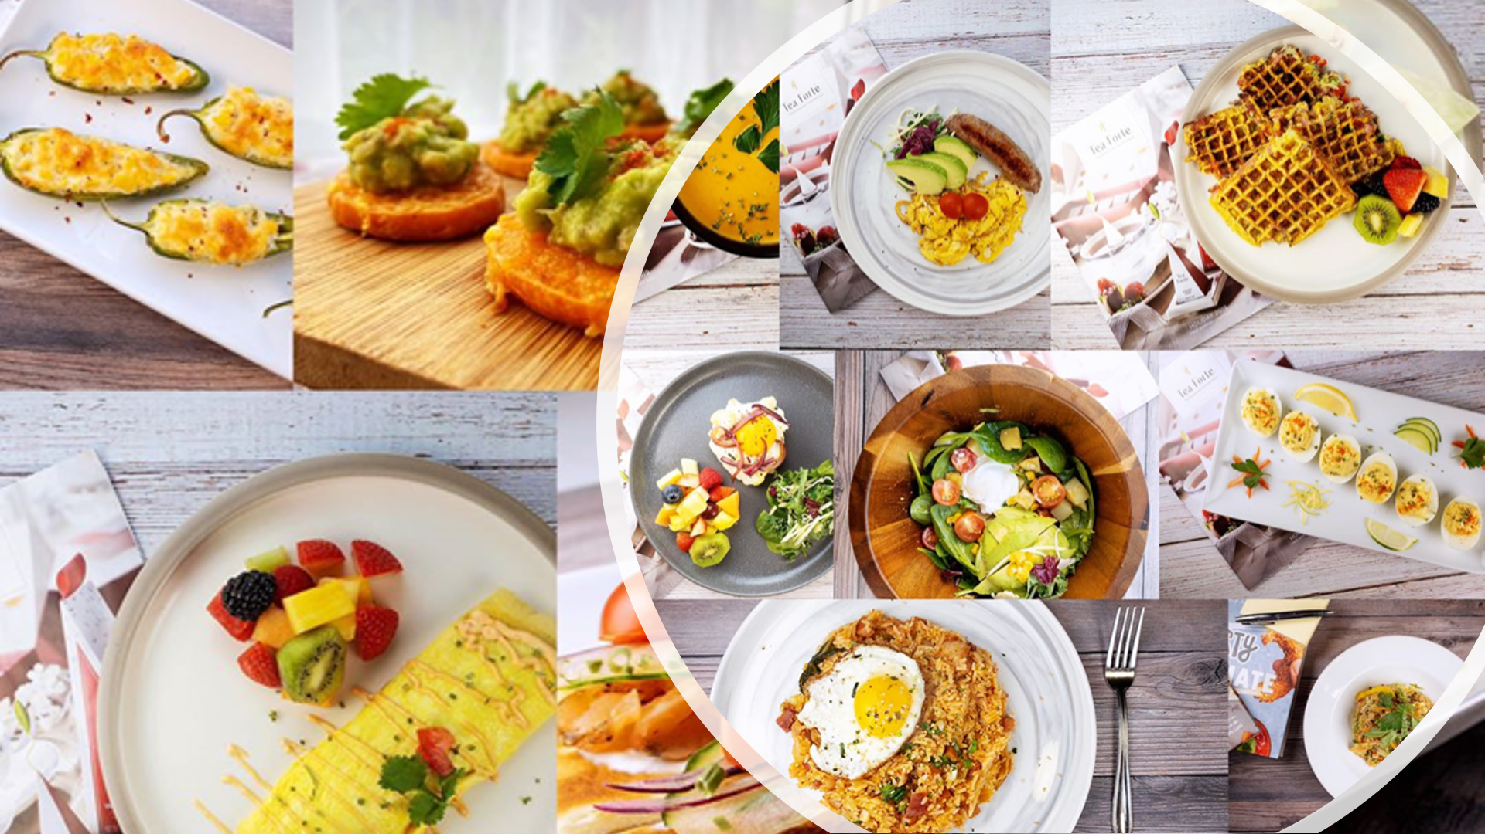

Slide 5
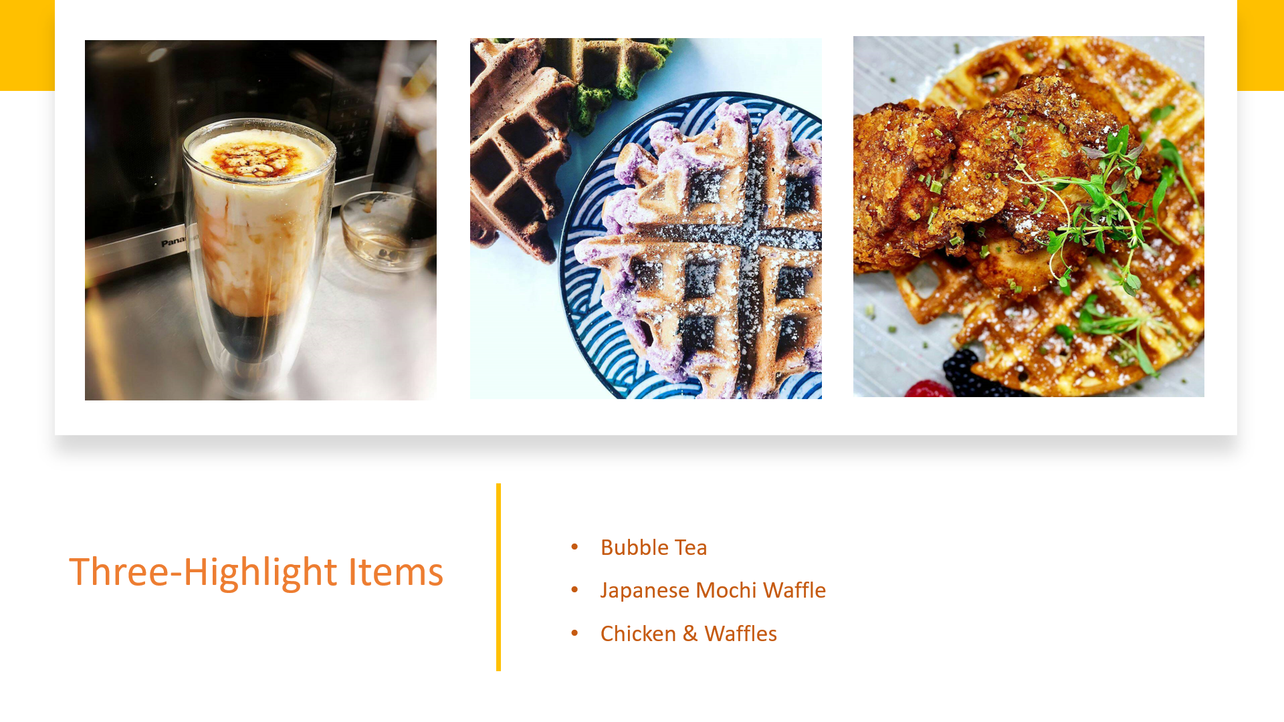

Slide 6
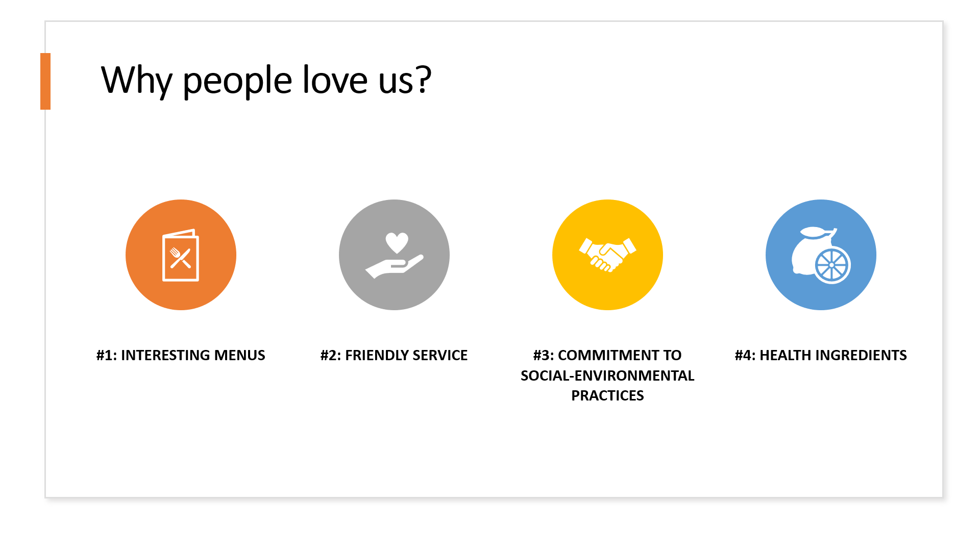

Slide 7


Slide 8
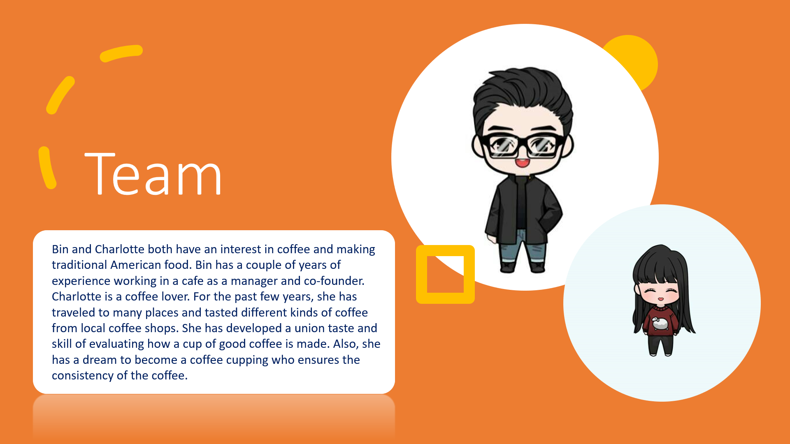

Slide 9
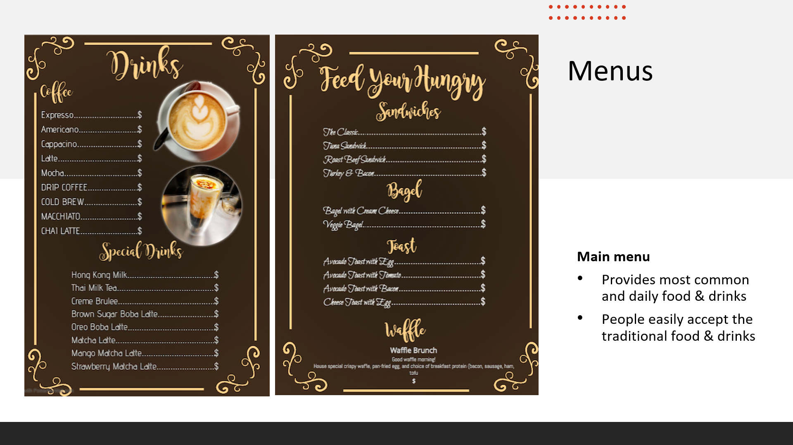

Slide 10
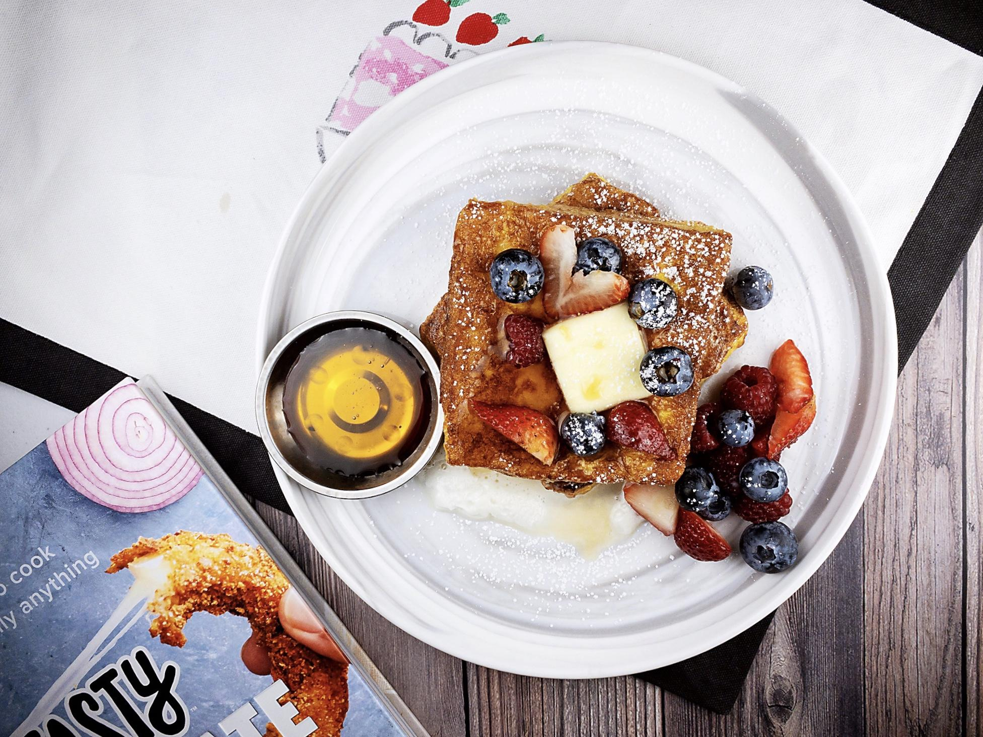
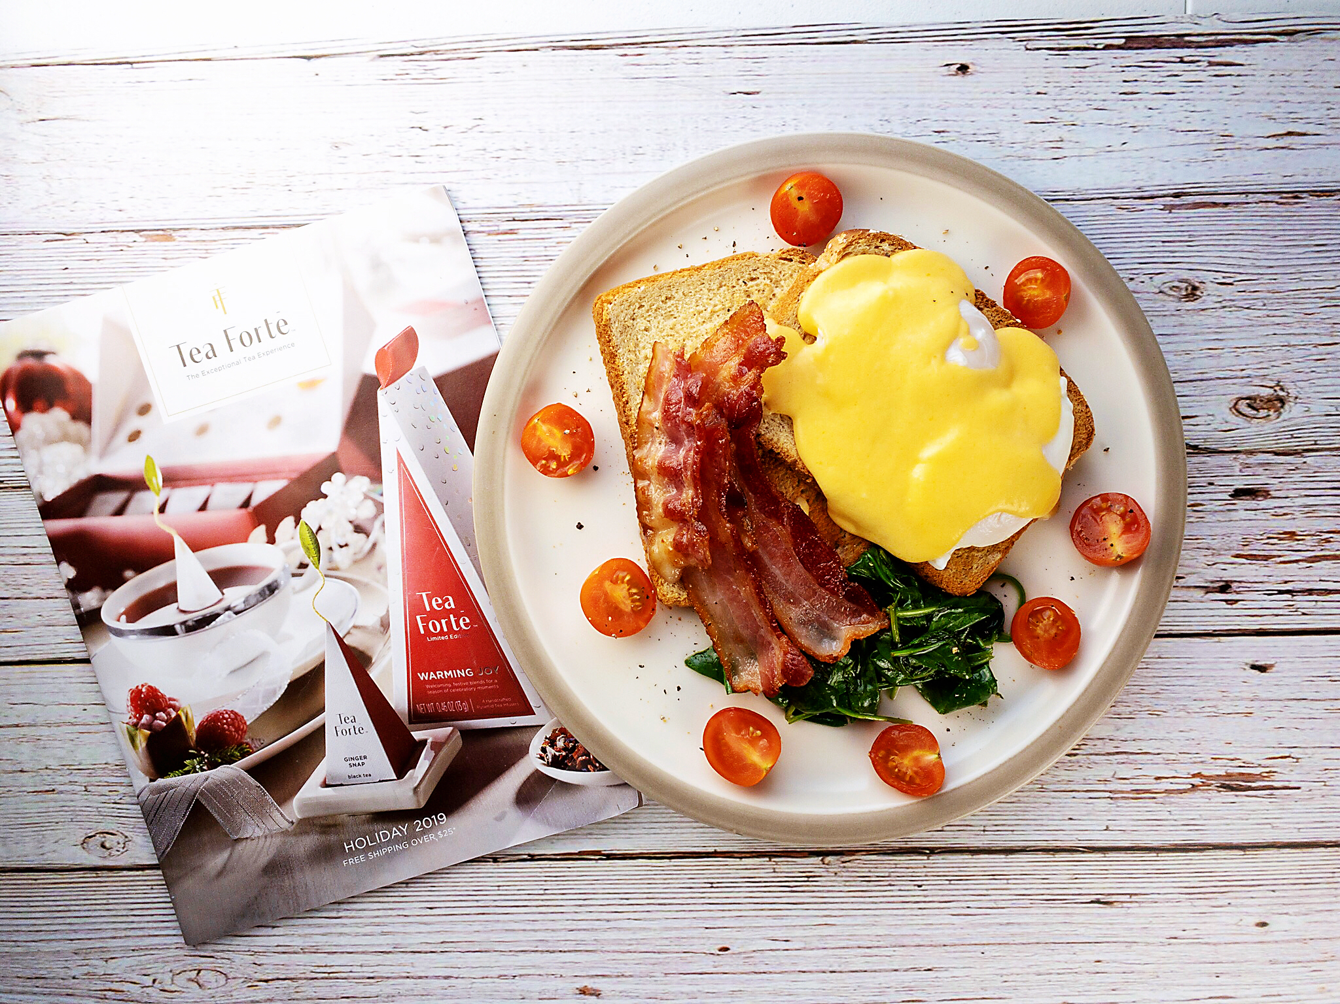
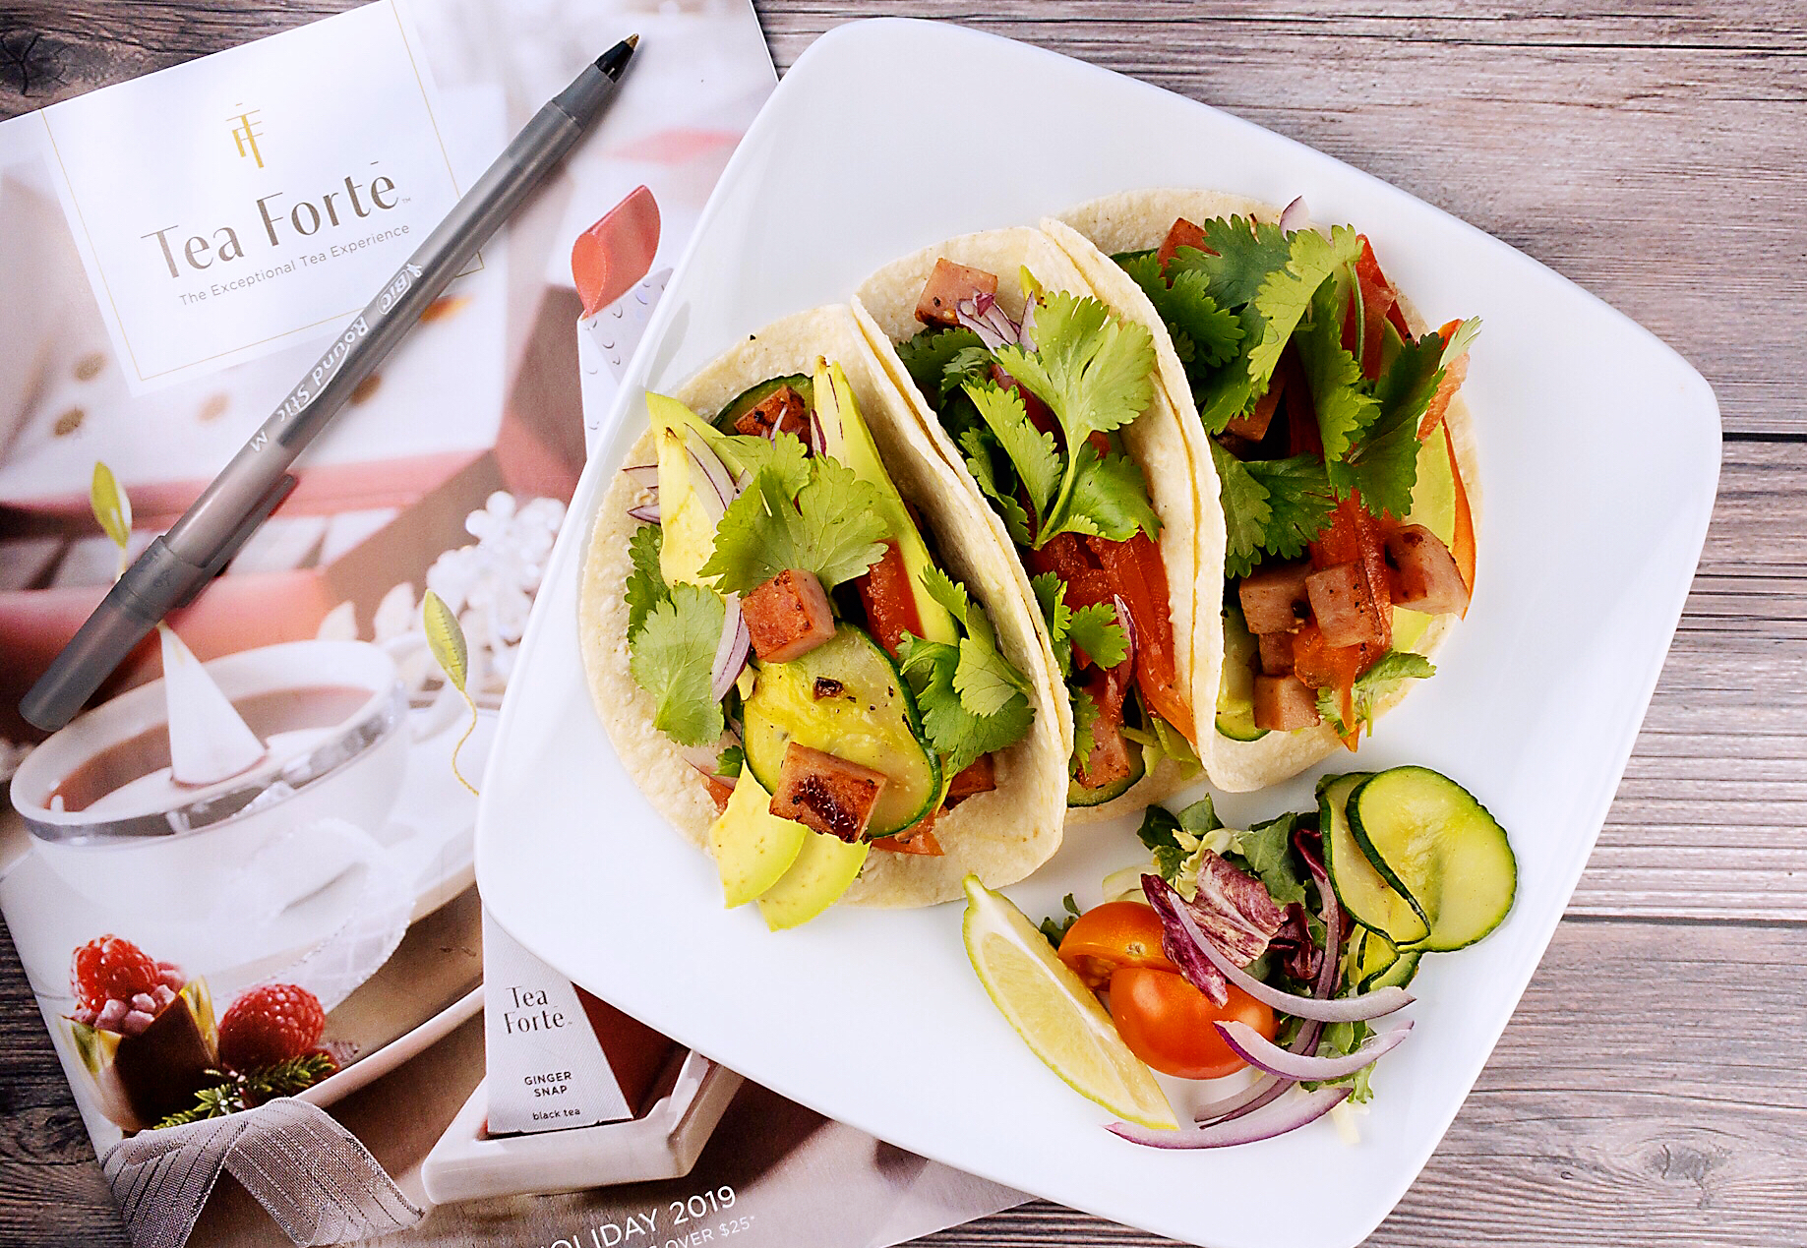
Bin’s daily Specialties
https://drive.google.com/file/d/178PcYLcUsfoygf5qoDXIDbHH44e4qzs1/view?usp=sharing
Receipts has been ready and tested
Notes:
Bin’s Daily Special Menu will be a small menu of 5 food & drink items. We will draw from a well of 50~100 recipes. We will update our menu every week (small change) and every month (big changes). Regulars will spot differences every time that they stop by and should be tempted to try new items.

